Slide 1
How to Obtain NCQA Recognition as A Patient Centered Medical Home
(and why you might not want to . . . )
Donald T. Stewart, MD
Sammamish Diabetes and Lipid Clinic
DonS@SDALC.org
IMP Camp 2009

Slide 2
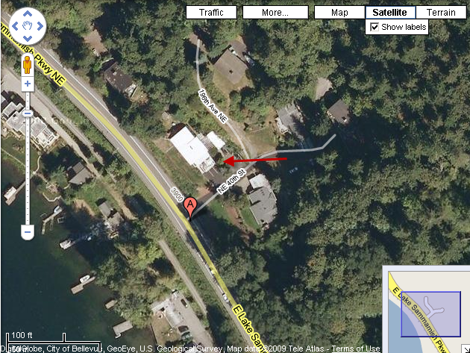
My Patient Centered Medical Home: Sammamish Diabetes and Lipid Clinic in Sammamish Washington
Notes:
After 24 years in a traditional practice, I decided to limit the number of patients I saw, and to cut costs by moving my office into the basement of my home.

Slide 3
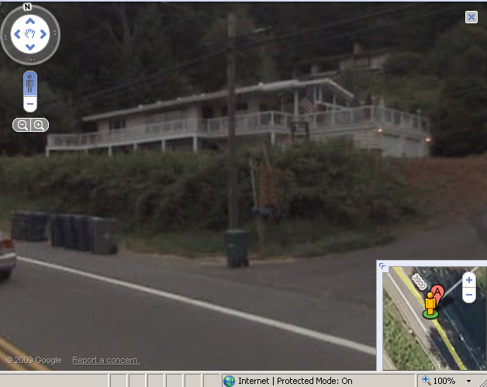
View from the Street, via Google
Notes:
We have no signs visible from the road, since we are not trying to attract new patients.

Slide 4
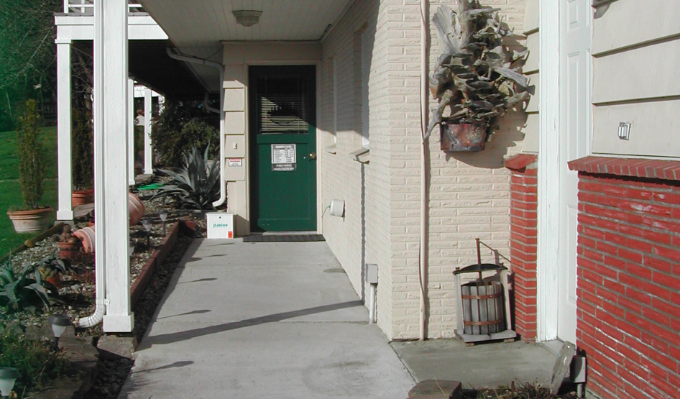
Patient Entrance
Notes:
To cut our start-up costs, my wife Eva poured the concrete for the entrance, hung the sheetrock, tiled the floors, and remodeled the bathroom.

Slide 5
Overview
Historical Considerations
Why Does a PCMH make sense?
Who is the NCQA?
Why become NCQA Recognized
Details and steps necessary to meet NCQA Recognition as a Patient Centered Medical Home
Notes:
This presentation was originally developed to be 1.5 hours long, and provided details of each of the NCQA PCMH criteria. The full slide set is available on my website, http://sdalc.org for anyone who wants to see all of the details.

Slide 6
Historical Considerations
“Medical Home” first used by American Academy of Pediatrics 1967 describing comprehensive services for developmentally disabled patients.
WHO Alma Alt Conference 1978 described the Medical Home concept with Primary Care as the centerpiece.
Institute of Medicine 1990s
AAFP 2002 Future of Family Medicine Project
Joint Statement by AAFP, AAP, ACP, AOA in 2007
Notes:
The phrase “medical home” has been around for well over 40 years.

Slide 7
Joint Principles of the Medical Home - February 2007
(AAFP, ACP, AAP, AOA)
Personal Physician
Physician Directed Medical Practice
Whole Person Orientation
Care is Coordinated and Integrated
Quality and Safety are Hallmarks
Access is Enhanced
Payment Reform
Notes:
This group of physician organizations came out with a position statement as to what a Medical Home was in February of 2007

Slide 8
What is Wrong with US Healthcare?
Too expensive
Unimpressive quality results
Poor access to care for many
Those who pay for healthcare (the government and the employers) want more value for their money
They believe that a stronger primary care system is an essential part of the solution
Notes:
There are many things that could be improved in US healthcare,

Slide 9
Why Isn’t Primary Care Valued?
Primary care is understaffed and underfunded
The simple and obvious solution to the problem would be to adequately fund and support primary care in the US
Political forces keep this from happening:
  Insurance companies like the status quo.
  Specialists (the majority of MDs) like the status quo.
  Hospitals, Equipment Manufacturers, Technology Firms, and Pharma all like the status quo.
Notes:
It is not necessary to prove to the members of this group that our healthcare system is broken, and that it is not structured to incentivize the provision of high quality patient centered care.

Slide 10
Why Does a PCMH Make Sense?
Given the political climate, a “gimmick” is necessary to adequately fund primary care.
The PCMH is that gimmick
  Our system of fragmented and impersonal care makes the words “Patient Centered Medical Home” resonate (It sounds good.)
  By emphasizing high-tech tracking of minutia, it has the appearance of accountability
  It promises cost savings by improved access and less waste
Notes:
The large primary care organizations (AAFP, AAP, ACP, AOA) have bought into the concept of rebranding primary care as the providers of Patient Centered Medical Homes. They feel that this is necessary for the survival of primary care.

Slide 11
What is the NCQA?
Private not-for-profit, formed in 1990, dedicated to improving health care quality in the United States
2007 Revenue $27,728,329.00
Leadership Team – 10 individuals
  1 MD
  2 RN
  7 others with a variety of credentials
Notes:
Although NCQA is a not-for-profit, it has an impressive revenue of almost $30,000,000.00 a year. Only one of the 10 individuals on the leadership team is a physician.

Slide 12
NCQA Board of Directors
16 people (many from dual categories)
  5 MDs
  2 Attorneys
  2 Insurance
  3 Academics
  3 Business
  3 Special Interest Groups
  Consultants / Misc.
Notes:
The 16-member board of directors of NCQA does have 5 MDs, but most of them wear many hats.

Slide 13
NCQA Sponsors
  Foundation Sponsors:
    American Diabetes Association
    American Heart Association/American Stroke Association
    The California Endowment
    The Commonwealth Fund
  Corporate Sponsors:
    Platinum: $250,000 and more (Pharma)
    Gold: $150,000 -$249,999 (Pharma and Partnership for Prevention)
    Silver: $50,000 - $149,999 (Pharma)
    Bronze up to $49,999 (30 some other organizations)
Notes:
The NCQA has a number of foundation sponsors, and has significant corporate sponsorship from Pharma.

Slide 14
NCQA Programs
Accreditation
  Health Plans
  Managed Care Organizations
  PPOs
  Disease Management
Certification
  Physician Organizations
  Health Information Products
  Credentials Verification Organizations
Physician Recognition
  Back Pain
  Diabetes
  Heart Disease and Stroke
  PPC - PCMH
HEDIS (Healthcare Effectiveness Data and Information Set)
  Yearly dataset revision
Notes:
NCQA runs a large variety of programs that offer accreditation, certification, and recognition, and it does the yearly revision of the HEDIS dataset, which is used for accreditation and quality ranking of health plans.

Slide 15
Why Become NCQA Recognized?
The pillars of high-quality primary care are simple:
  Access
  Efficiency
  Continuity
  Good information
  Coordination
These are too easily assessed and measured to qualify as the “gimmick” necessary in our political climate to fund primary care
Notes:
Because NCQA is widely accepted as a certifying body, it was approached by the PCCCC (an organization comprised of a great many of the stakeholders in health care) to set up criteria and a recognition program for a “Patient Centered Medical Home.” The idea was that there would be more funding for primary care practices that met the criteria. For NCQA to justify its continued participation in this process, the criteria needed to be unnecessarily complex and difficult to measure. If a simple, well validated tool like Hows YourHealth? were used instead, the NCQA would not be able to justify its fees or its participation in the rating process.

Slide 16
The Irony of NCQA Recognition
Large organizations, top-heavy with administration, that most people would never consider to be “Medical Homes,” need some way to justify their existence, and to appear to provide quality care
Small practices, who have been practicing patient-centered care for decades, need to be “rebranded” to qualify for adequate funding
The dilemma is that it will be much easier for large, impersonal organizations to become recognized as medical homes by NCQA criteria than small, personal practices that excel in the pillars of quality care
Notes:
Unfortunately, the complexity and expense of the NCQA recognition process will make it very difficult for small practices that are providing superb patient centered care to become recognized, while large practices that have the resources to develop written policies and to generate documentation can become recognized without really any significant amount of what we would call being “patient centered”

Slide 17
Details and Steps Necessary to Meet NCQA Recognition as a Patient Centered Medical Home
10 “Must Haves”
9 Standards
100 points
Notes:
The NCQA criteria has 9 general areas of focus, or “Standards,” divided into 30 subsets, including 10 “must have” elements, and awards up to 100 points to practices meeting all of their criteria.

Slide 18
NCQA Medical Home – Musts
Has written standards for patient access and patient communication;
Uses data to show it meets its standards for patient access and communications;
Uses paper or electronic charting tools to organize clinical information;
Uses data to identify important diagnoses and conditions in practice;
Implements evidence-based guidelines for at least three conditions;
Actively supports patient self-management;
Tracks tests and identifies abnormal results systematically;
Tracks referrals using a paper-based or electronic system;
Measures clinical or service performance by physician or across the practice;
Reports performance by physician or across the practice.
Notes:
The “Must Haves” for recognition, at face value, seem reasonable.

Slide 19
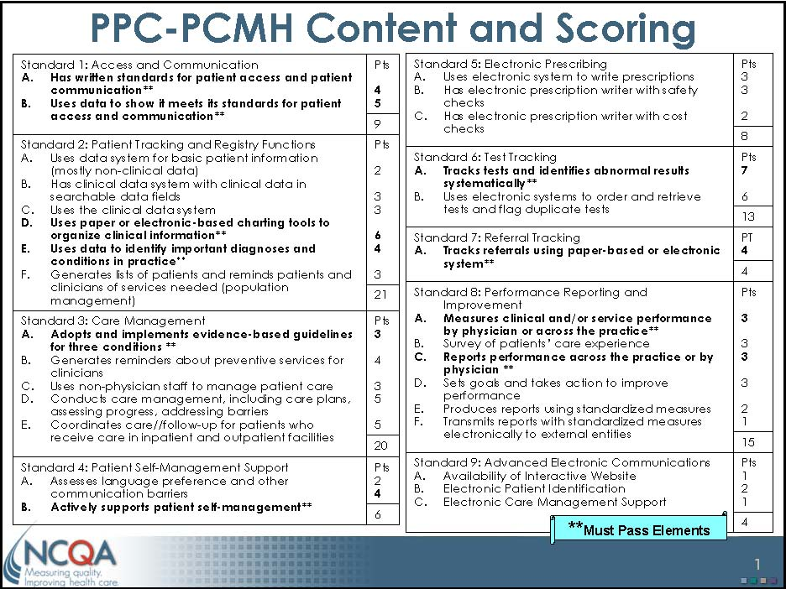
Notes:
This is the overview chart that gives the roadmap to the recognition process

Slide 20
PPC-PCMH Scoring
Level of Qualifying | Points | Must Pass Elements at 50% Performance Level
Level 3 | 75 -100 | 10 of 10
Level 2 | 50 – 74 | 10 of 10
Level 1 | 25 – 49 | 5 of 10
Not Recognized | 0 – 24 | < 5
Levels: If there is a difference in Level achieved between the number of points and “Must Pass”, the practice will be awarded the lesser level; for example, if a practice has 65 points but passes only 7 “Must Pass” Elements, the practice will achieve at Level 1.
Practices with a numeric score of 0 to 24 points or less than 5 “Must Pass” Elements do not Qualify.
Notes:
NCQA recognizes 4 levels of Medical Home recognition.

Slide 21
Steps to NCQA Recognition
Download Application packet (and study it)
  Dense 84 page Standards and Guidelines PDF
  21 page agreement and attestation PDF
  3 more documents totaling 11 pages
  Two Excel Spreadsheets to fill out
Download Survey Tool ($80.00)
Gather data from your practice to support criteria
Upload documentation to NCQA
Send in application and fee ($450.00)
Notes:
This explains the steps in the actual process of obtaining recognition

Slide 22
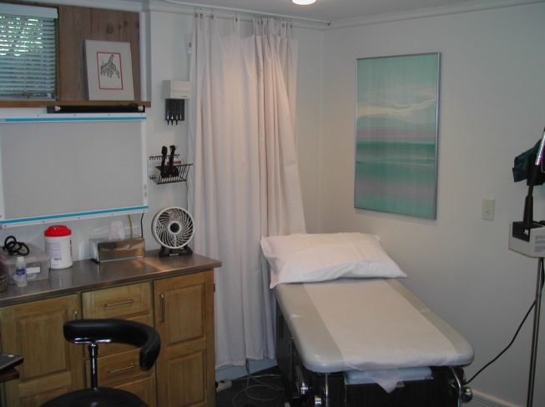
Notes:
We will take a break and look at my exam room. The power table was a few hundred dollars at a local medical surplus store, where I also got the anesthesiologist’s stool for $30.00. The stainless steel topped cabinet cost a few hundred dollars, and the x-ray viewer was a gift.

Slide 23
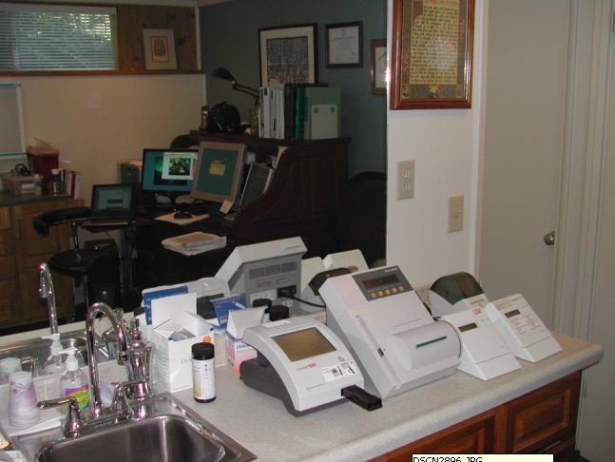
Notes:
I do in-house testing of lipids, AST and ALT, HgbA1c, Microalbumin/Creatinine and a few other things.

Slide 24
The Details
(wherein the devil resides)
(the full version of this slide deck is available at http://SDALC.org )
Notes:
The rest of this discussion will be on the specifics of meeting the NCQA Criteria. We only have time to discuss a couple of the standards, but the full discussion is available at my web site.

Slide 25
Notes:
We will focus on the details of Standard 1.

Slide 26
Standard 1 – Access and Communication Processes
1 A: The practice establishes policies in writing to support patient access (Must Pass):
  Scheduling each patient with a personal clinician for continuity of care
  Coordinating visits with multiple clinicians and/or diagnostic tests during one trip
  Determining through triage how soon a patient needs to be seen
  Maintaining the capacity to schedule patients the same day they call
  Scheduling same-day appointments based on practice’s triage of patients’ conditions
  Scheduling same-day appointments based on patient’s/family’s request
Notes:
You will be scored on how many of the 12 specific policies they have listed that you can document.

Slide 27
Standard 1 – Access and Communication Processes
1 A: Policies in writing (continued-Must Pass)
  Providing telephone advice on clinical issues during office hours by physician, nurse or other clinician within a specified time
  Providing urgent phone response within a specified time, with clinician support available 24 hours a day, 7 days a week
  Providing secure e-mail consultations with the physician or other clinician on clinical issues, answering within a specified time
  Providing an interactive practice Web site
  Making language services available for patients with limited English proficiency
  Identifying health insurance resources for patients or families who do not have insurance

Slide 28
Documenting 1A
Sending NCQA your written policies
Scoring 1A: the number of policies you produce (4 points possible)
  100%: written policies for 9 – 12 items
  75%: written policies for 7 – 8 items
  50%: written policies for 4 – 6 items
  25%: written policies for 2 – 3 items

Slide 29
1 A: Examples of Policies
  Patients schedule themselves online 24/7, and continuity of care is guaranteed because there is only one provider
  Dr. Stewart provides all patient care and does all diagnostic tests at the office, so care is coordinated at all times
  Patients who are unable to determine when or whether they need to be seen can call Dr. Stewart on his cell phone for help with triage.
  The practice will never allow more than 6 hours a day to be prescheduled, allowing 18 hours of capacity each day for same day appointments
  If the patient needs triage to determine that a same day appointment is appropriate, the same-day appointment will be granted
  If patient’s/family’s would prefer to request a same-day appointment, rather than simply schedule it, they will be allowed to request it.
Notes:
These are examples of written policies that apply to my practice

Slide 30
1 A: Examples of Policies (cont.)
  Dr. Stewart will provide telephone advice on clinical issues within 6 hours of the call.
  All patients have direct access to Dr. Stewart via his cell phone 24 hours a day, 7 days a week
  Dr. Stewart will answer e-mail consultations on clinical issues within 48 hours.
  All patients are encouraged to use our interactive practice Web site for scheduling, review of lab results, and secure communications
  Although the practice is closed and none of our current patients have limited English proficiency, if the practice ever opens up to new patients, those with limited English proficiency will be provided appropriate language services
  The practice routinely provides packets of health insurance resources for patients or families who do not have an insurance that we accept

Slide 31
1B: The practice’s data shows that it meets access and communication standards in 1A (Must Pass):
Visits with assigned personal clinician for each patient
Appointments scheduled to meet the standards in 1A
Response times to meet standards for timely response to telephone requests
Response times to meet standards for timely response to e-mail and interactive Web requests
Language services for patients with limited English proficiency
Notes:
While you can get only 4 points for having 12 policies, you can get up to 5 points for having data to document that you implement your policies

Slide 32
Documenting 1B
Reports, screen shots, hand tracking forms. The response times are one of the most difficult things to document for a small practice.
Scoring 1B: number of items supported by data (5 points possible)
  100%: Data supports 5 items
  75%: Data supports 4 items
  50%: Data supports 3 items
  25%: Data supports 2 items

Slide 33
Notes:
We only have time to discuss one of the sets of elements of standard 2, which is patient tracking and registry functions

Slide 34
Standard 2 – Patient Tracking and Registry Functions
2A: The practice uses a data system for patients that includes the following searchable patient information:
  Name
  Date of birth
  Gender
  Marital status
  Language preference
  Voluntarily self-identified race/ethnicity
  Address
  Telephone (primary contact number)
  E-mail address (or “none” for patient)
Notes:
Standard 2a lists 18 specific data elements that need to be tracked. While these elements are worthy of tracking, requiring that they all be “searchable” fields shows a lack of understanding by the NCQA of database design and of how a registry might be used in patient care.

Slide 35
Standard 2 – Patient Tracking and Registry Functions
2A: Searchable information (cont.)
  Internal ID
  External ID
  Emergency contact information
  Current and past diagnoses
  Dates of previous clinical visits
  Billing codes for services
  Legal guardian
  Health insurance coverage
  Patient/family preferred method of communication

Slide 36
Problems with 2A
Requirements far beyond CCHIT EMR requirements:
  I had to add numerous data fields to my CCHIT approved EMR
Requirements make no clinical sense:
  Why would anyone want to do a search on the name of an emergency contact or the legal guardian of a patient?

Slide 37
Documentation of 2A
A report must be generated to show how many of the 18 data elements have been completed for 75% or more of the patients seen in the previous 3 months.
Scoring: (2 points possible)
  100% 12 – 18 items documented for 75%
  75% 8 – 11 items documented for 75%
  50% 6 – 7 items documented for 75%
  25% 4 – 5 items documented for 75%

Slide 38
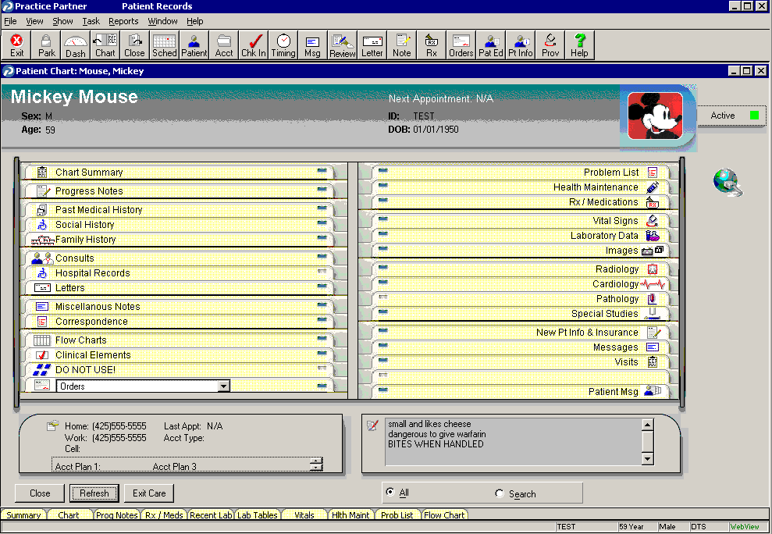
McKesson Practice Partner EMR

Slide 39
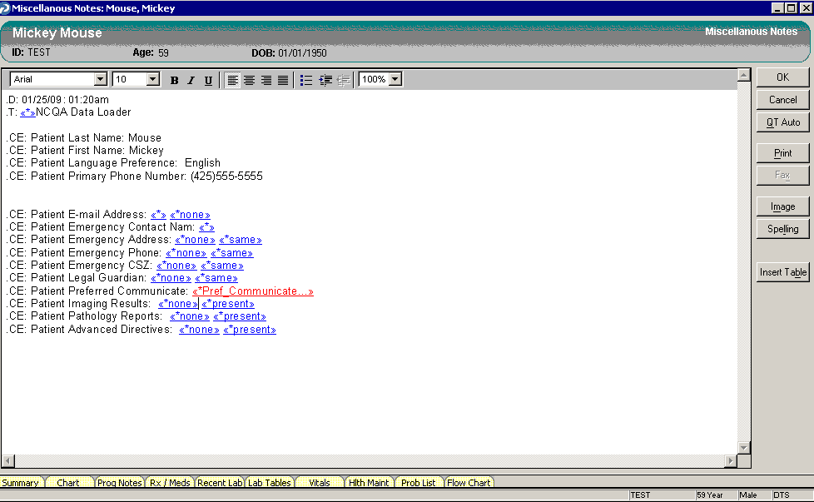
Custom Data Loading Screen for NCQA Data

Slide 40
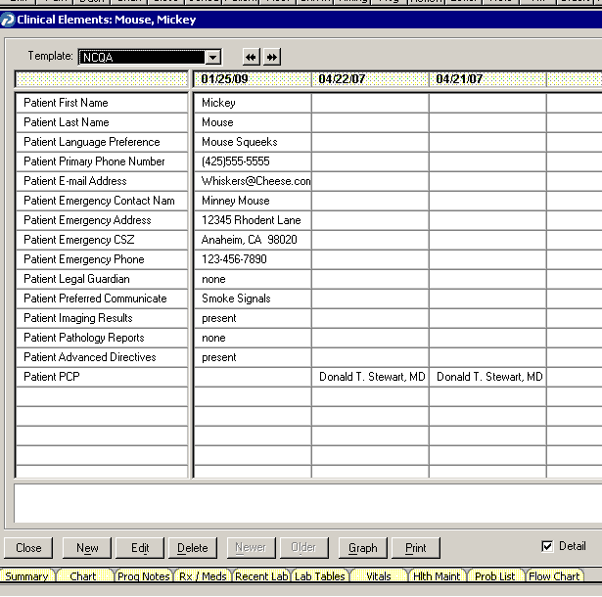
NCQA Data in a Clinical Element Table

Slide 41
2B: The practice’s clinical data system or systems to manage care of patients include the following clinical patient information in searchable data fields:
  Status of age-appropriate preventive services (immunizations, screenings, counseling)
  Allergies and adverse reactions
  Blood pressure
  Height
  Weight
  Body mass index (BMI) calculated
  Laboratory test results
  Presence of imaging results
  Presence of pathology reports
  Presence of advance directives
  Head circumference for patients 2 years or younger

Slide 42
2C: The practice uses the fields listed in 2B consistently in patient records.
Calculate the percentage of patients seen in the past three months that have at least seven of the eleven fields from 2B completed in their electronic record.
Scoring: (3 points possible)
  100%: 75%-100% have at least seven fields
  75%: 50%-74% have at least seven fields
  50%: 25%-49% have at least seven fields
  25%: 10%-24% have at least seven fields

Slide 43
Notes:
In the interest of saving time, we will skip over the rest of standard 2, and move directly to standard 8b

Slide 44
8B: Collects patient experience data in the following areas:
1. Patient access to care
  Ability to make an appointment and see a physician
  Timeliness and quality of phone calls
  Office wait time
2. Quality of physician communication
  Responses to patient and family questions
  Instructions and information about diagnosis, treatment, medication and follow-up care
  The degree to which patients and families feel that they are partners in health-care management
Notes:
This is one part of the NCQA criteria that I like.

Slide 45
8B: Patient Experience Data (cont.)
3. Patient/family confidence in self care
  Patient knowledge of and ability to provide self-care involving activity, exercise, medications and reporting changes in their symptoms
4. Patient/family satisfaction with care
  Satisfaction with staff, physician and others
  Satisfaction with treatment
  Satisfaction with response to patient/family choices

Slide 46
The Irony of 8B
The 4 data items listed in 8B are the pillars of a high-performing health care system:
  Access
  Efficiency
  Continuity
  Good information
  Coordination
Yet, this is not a Must-Pass item, and it only accounts for 3% of points in the NCQA scheme.

Slide 47
Documentation of 8B
Phone, paper or electronic survey reflecting experience of sampling of all patients in practice with summary of results. (Could use Hows YourHealth? for validated data or Survey Monkey for quick and dirty survey.)
Scoring: number of areas of data collected (3 points possible)
  100%: Data collected on 3 – 4 areas
  50%: Data collected on 1 – 2 areas

Slide 49
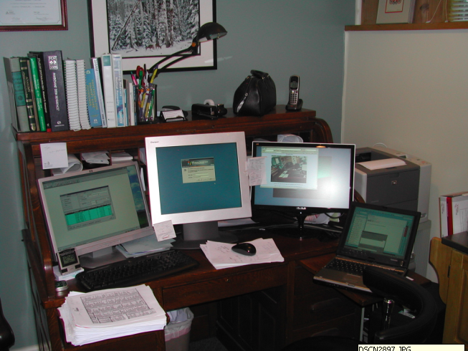
Advanced Electronic Communication at the Exam Room Desk
Notes:
Four screens plugged into two computers in my office. What is always running:
Window into my EMR
Window to the inbox of my Fax Server
Internet Explorer with links open to:
Epocrates
MD Consult
Google
AppointmentQuest
The practice Web Site
E-LabCorp
Outlook inbox
Web Cam in the Waiting Room
Directory of often-used forms for the practice
CDL
Disabled Parking Request
Radiology order form
Joslin Referral form
Sleep Consultants Referral form

Slide 50
Conclusions
NCQA recognition as an Advanced Medical Home is not particularly difficult, but is very time consuming and is expensive, especially for a small practice where the physician will be doing much of the work.
Only a small percentage of the points counted actually relate to activities that define a high-performing primary care system.
Notes:
We have discussed about 15% of the criteria necessary to achieve recognition by the NCQA as a Patient Centered Medical Home. Unfortunately, only a very small percent of the criteria actually relate to pateint-centeredness.

Slide 51
Conclusions
The vast majority of the points counted relate to how sophisticated the practice’s EMR is, and whether the practice has staff devoted to writing administrative policies, not to whether the practice performs well.
The level of evidence supporting this concept is far below the standard which physicians are expected to use for clinical decisions.
There is a potential for some financial benefit to achieving recognition, though this remains to be seen.
Notes:
While it would be gratifying to achieve yet another recognition for quality, the risk one runs in focusing on NCQA recognition is that of being distracted by the process, and having our energy taken away from the real work of providing high quality patient centered care.

Slide 52
Thank You
And feel free to contact me regarding specifics on this.

